Slide 1

NextGene School
Admin Portal

Slide 2
Dashboard
01

Slide 3
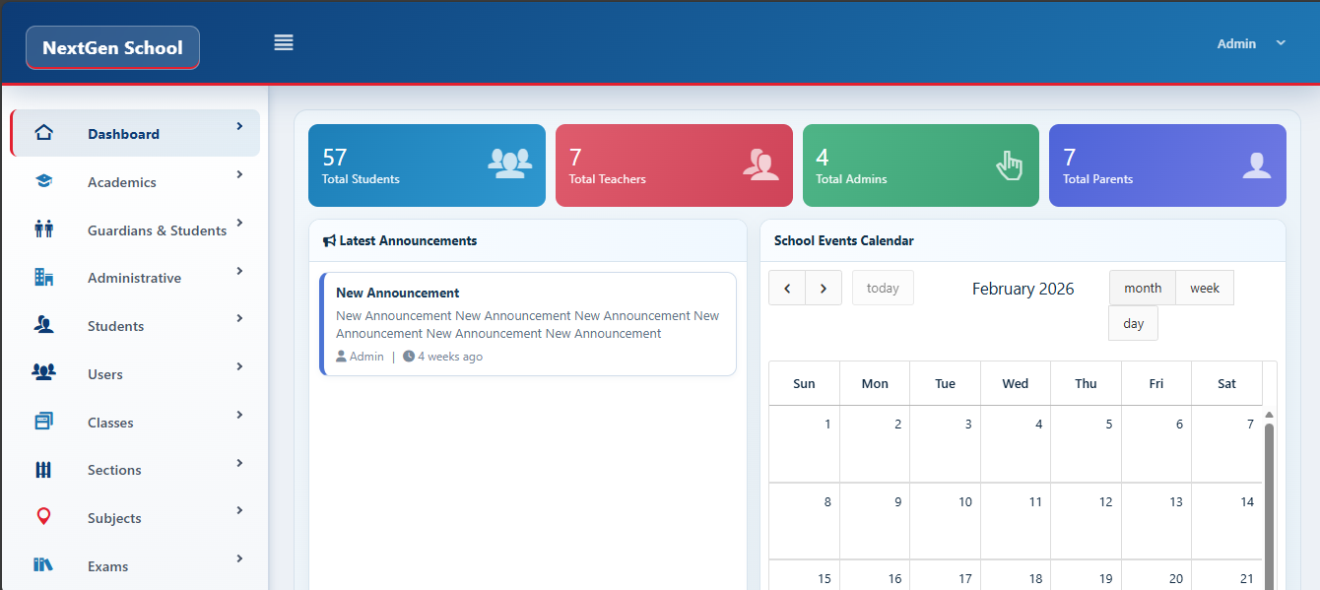
From your dashboard page you can see the latest announcement and see the school calebder

Slide 4

Time Table
02

Slide 5
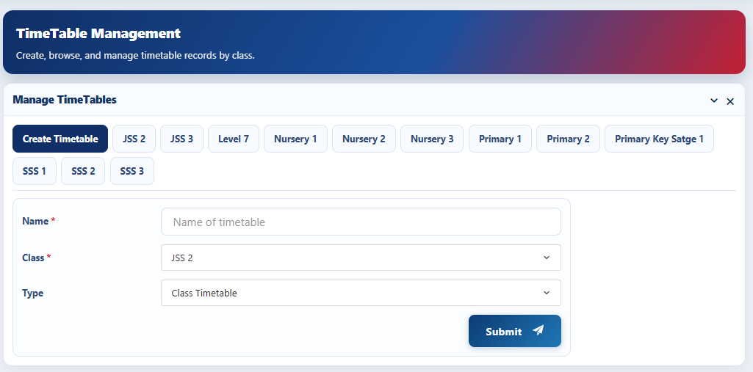
You can create , manage and view timetable for all classes

Slide 6
Guardians and Students
03

Slide 7
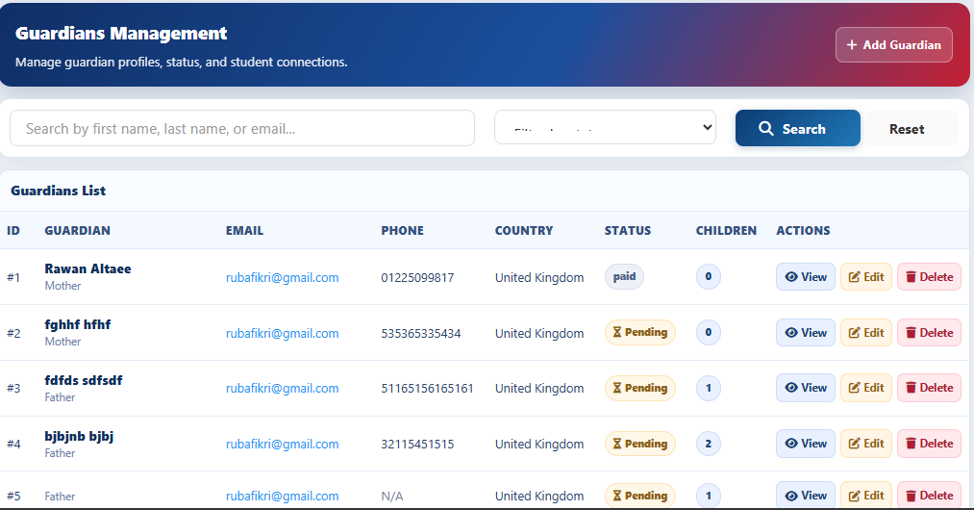
Manage all registerd parents from our wrbsite

Slide 8
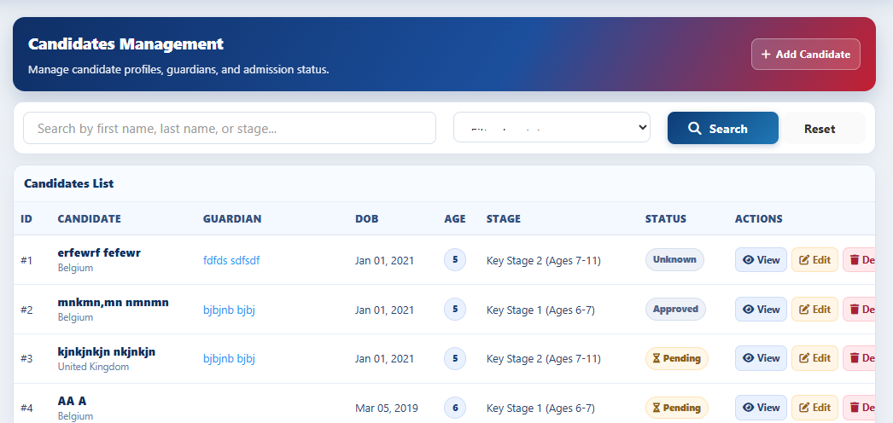
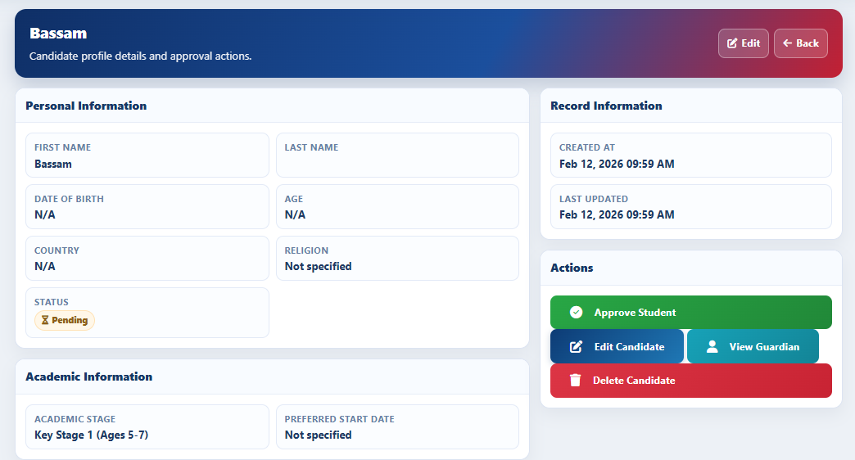
See all student candidate and accept them in our study

Slide 9
Payment
04

Slide 10
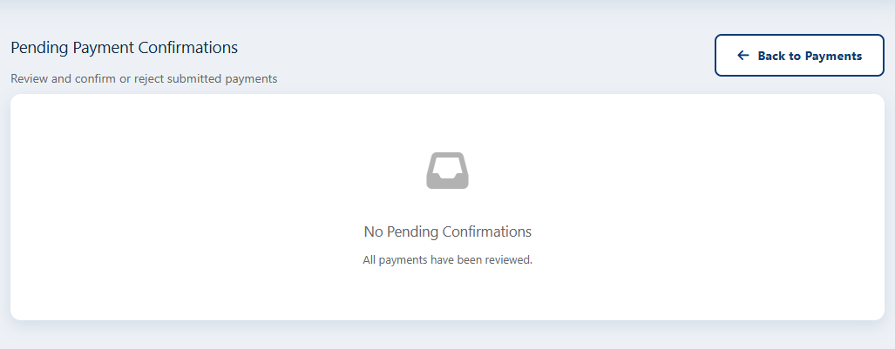
From here you can confim parents payments

Slide 11
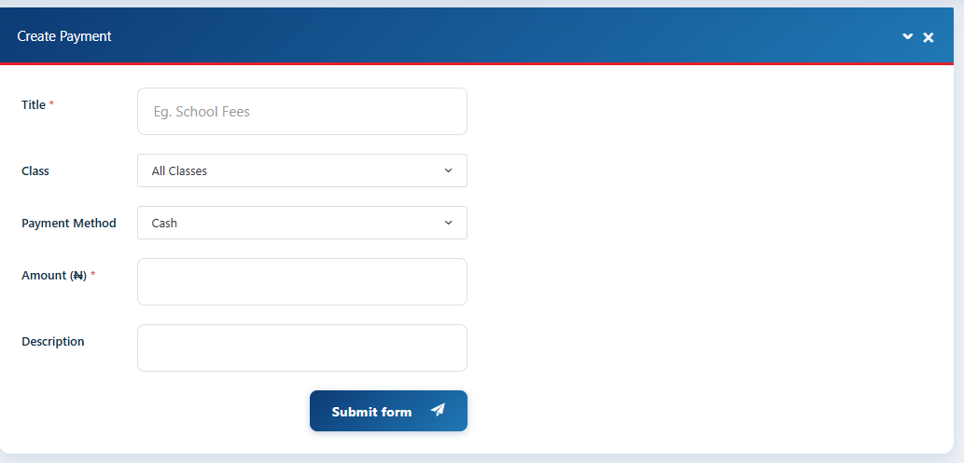
From here you can manage students payments and assign new payment

Slide 12
Student
Managments
05

Slide 13
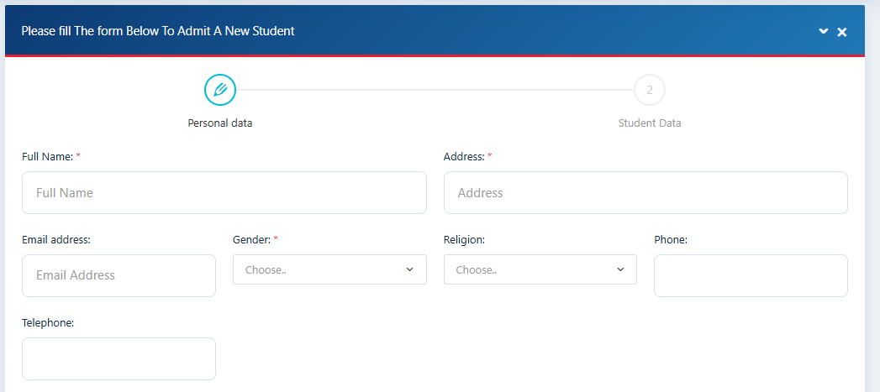
From here you can admit new student

Slide 14
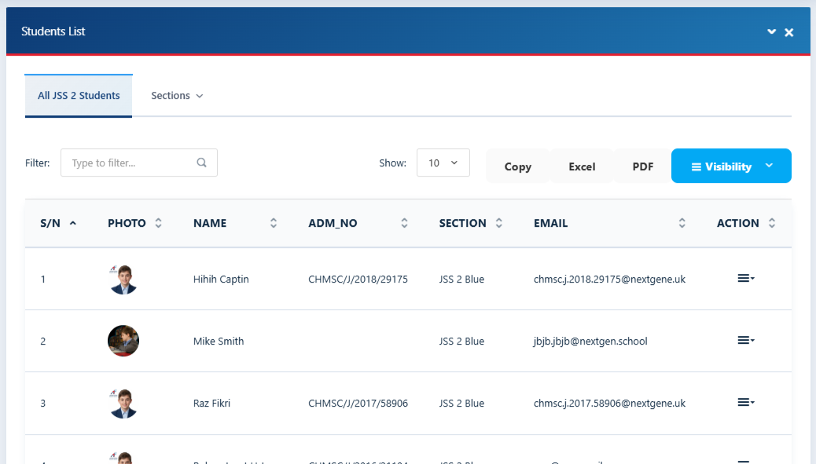
From here you can see student list and manage every student profile

Slide 15
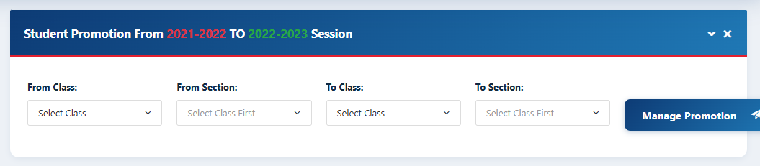
From here you can manage student promotion

Slide 16
Manage Users
06

Slide 17
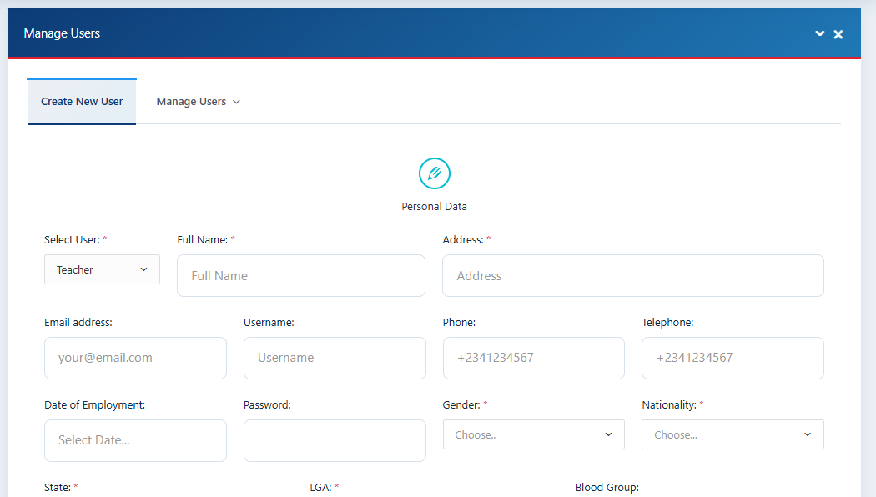
Froom here you can add any type of users do you want (Admin , Teacher , Parent)

Slide 18
Manage Classes
07

Slide 19
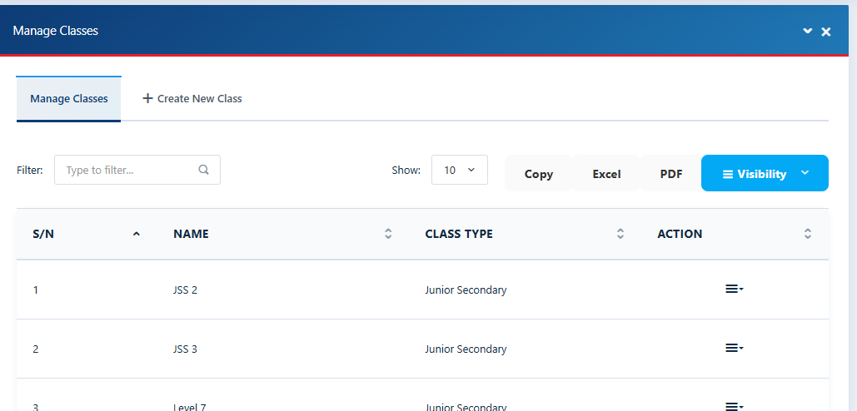
Froom here you can add new class, manage classes.

Slide 20
Manage Sections
08

Slide 21
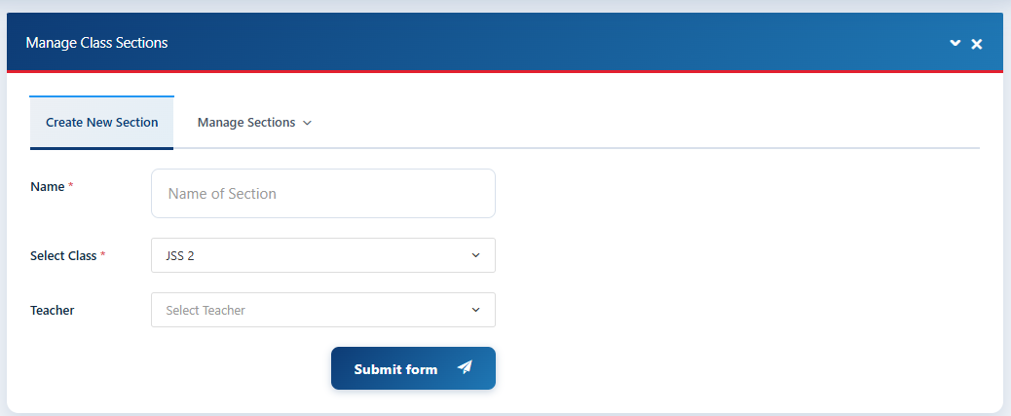
Froom here you can add new section for class , manage sections.

Slide 22
Manage Subjects
09

Slide 23
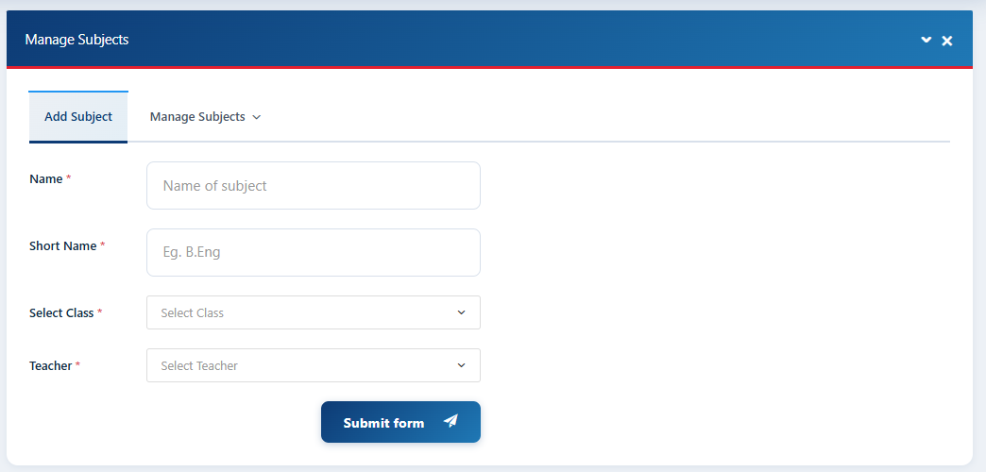
Froom here you can add new subject for class , manage subjects.

Slide 24
Manage
School Clubs
10

Slide 25
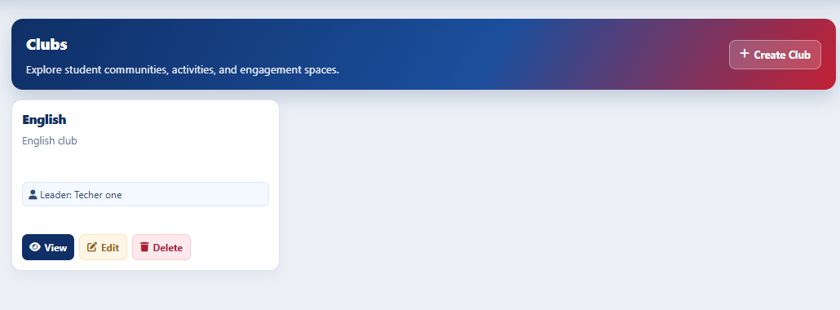
Froom here you can add new Club for class , manage Clubs.

Slide 26
Manage Advisory Corner
11

Slide 27
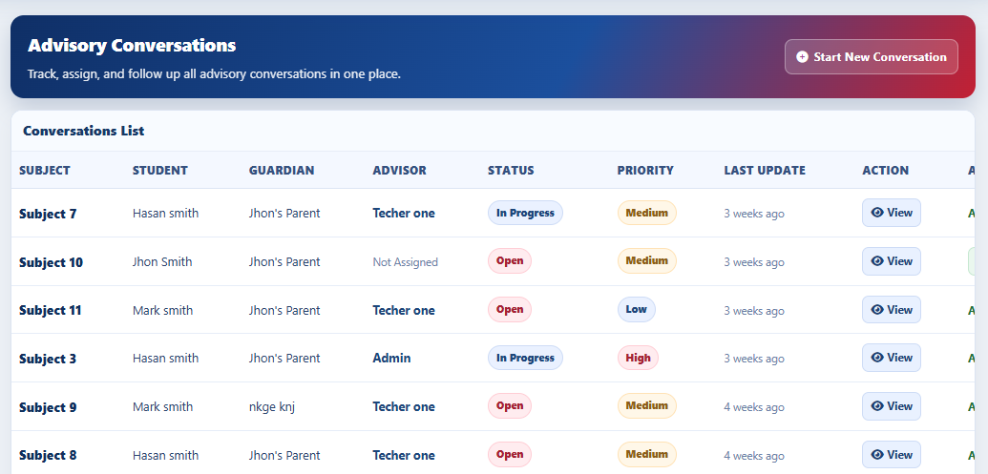
Froom here you can create new conversation with any parents , and can assign the conversation to specific advisor.

Slide 28
Manage Announcements
12

Slide 29
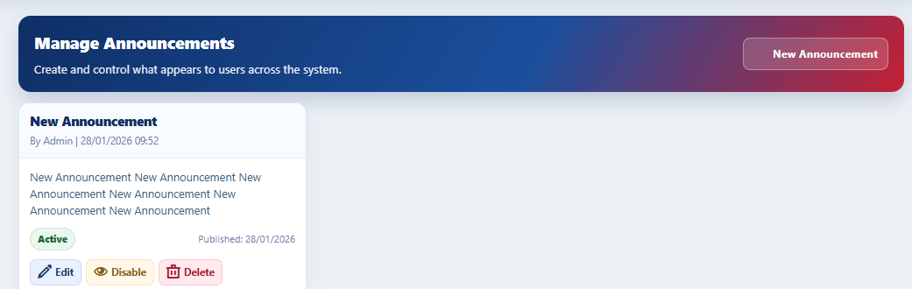
Froom here you can create new announcement to show to all students member

Slide 30
Manage Islamic Materials
13

Slide 31
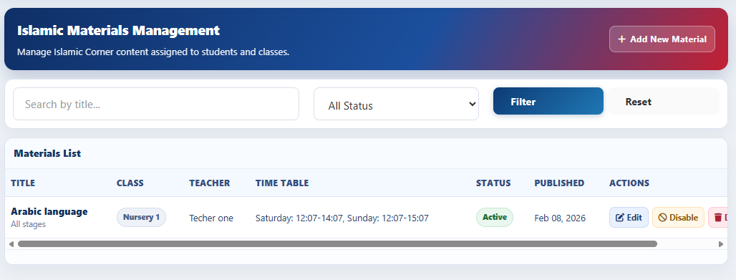
Froom here you can create new islamic material and manage it

Slide 32
Manage Settings
14

Slide 33
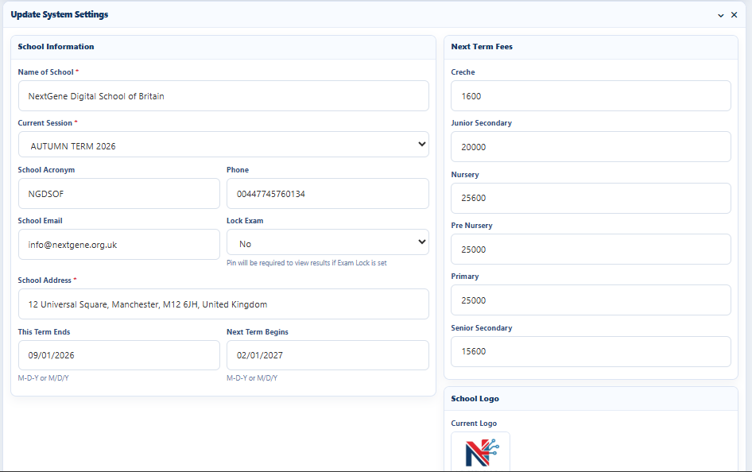
From here you manage you site settings

Slide 34
Manage Profile
15

Slide 35
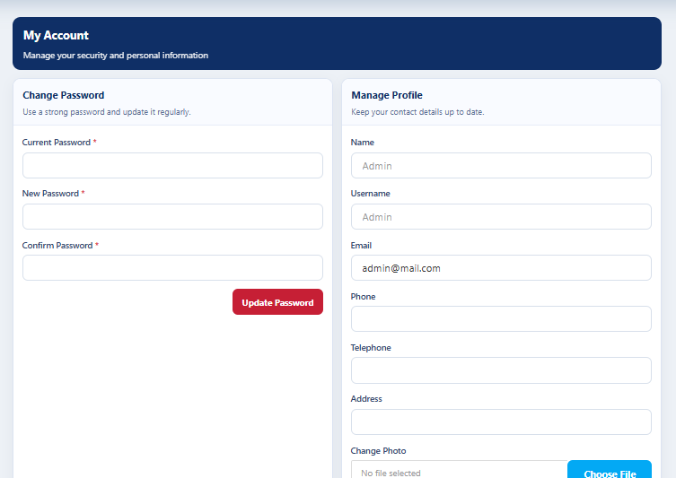
From here you manage your profile

Slide 36
Thank You

